Slide 1
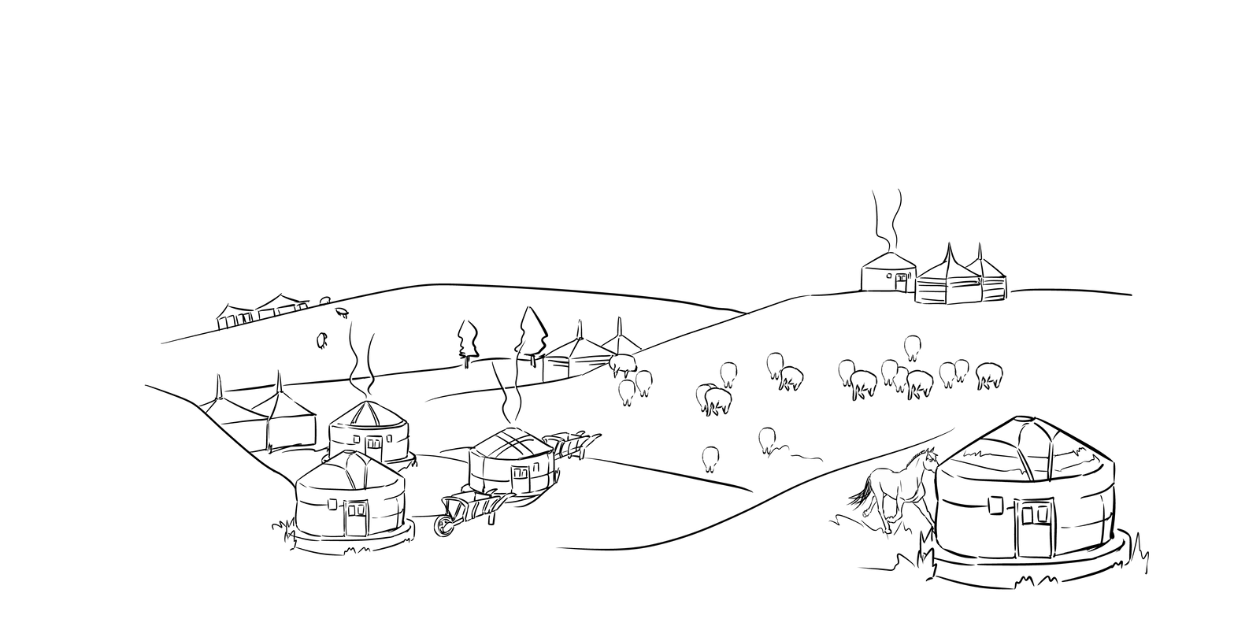
HACKATHON, FALL 2023
DIGITAL NOMADS
DATA ANALYSTS: AMINA BAUYRZHAN ,
ASSEL KASSENOVA ,
NURSULTAN YESBOLATOV

Slide 2
TABLE OF CONTENT
BUSINESS OVERVIEW
EDA & STATISTICAL ANALYSIS
PREDICTED CHARGES
FURTURE DEVELPMENT PLAN

Slide 3
DIGITAL NOMADS INSURANCE
focuses on insurance charges based on customer profiles. It addresses the challenge of accurately determining insurance premiums that align with individual policyholders' characteristics, striking a balance between competitive pricing and the financial stability of the company.

Slide 4
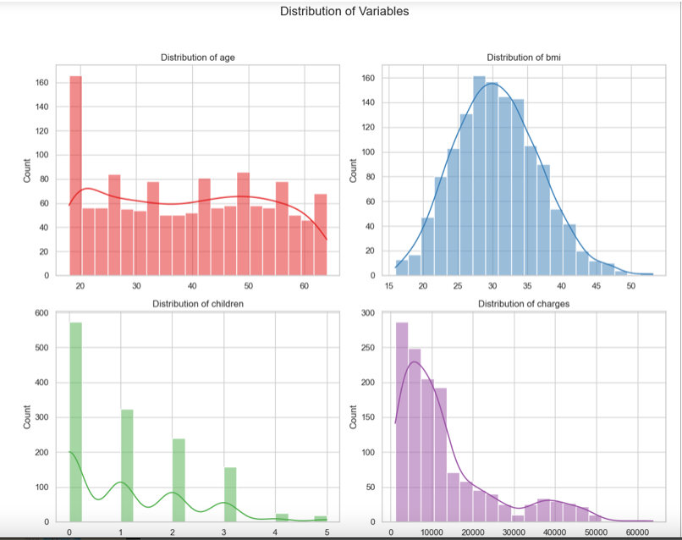
About Dataset
We have a right-skewed distribution for charges, it means that there are more data points with lower charges and fewer data points with higher charges.
BMI more like normally distributed with slight right skewness.
Also there are fewer clients with more children, whereas the vast majority are child free.

Slide 5
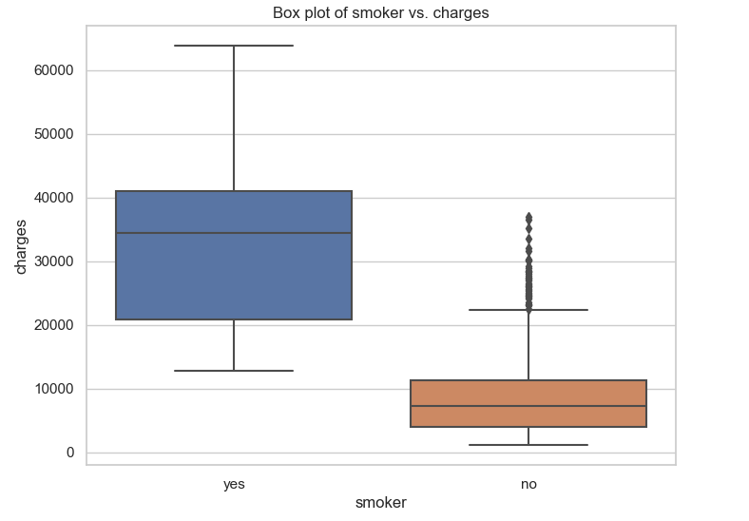
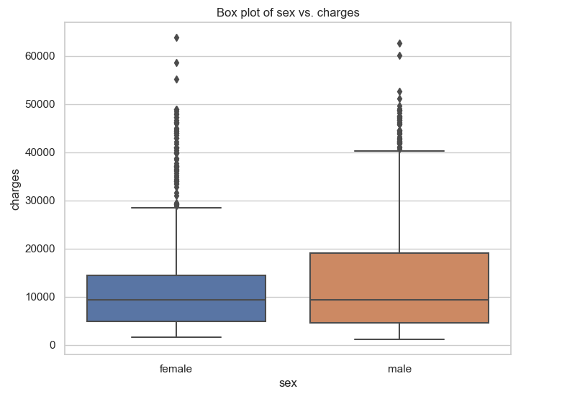
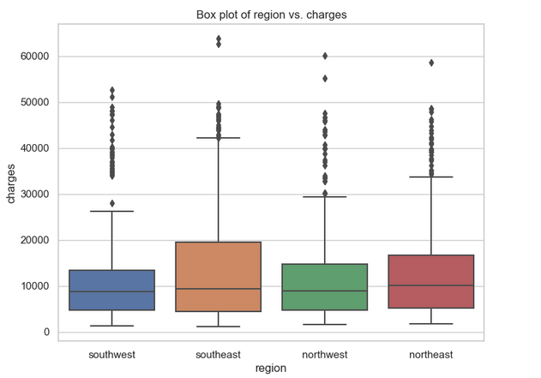
In our dataset there are more smokers, while they also has higher variability. Also smokers have significantly higher rates of charges. among non-smokers there are few outlier cases with higher charges.

Slide 6
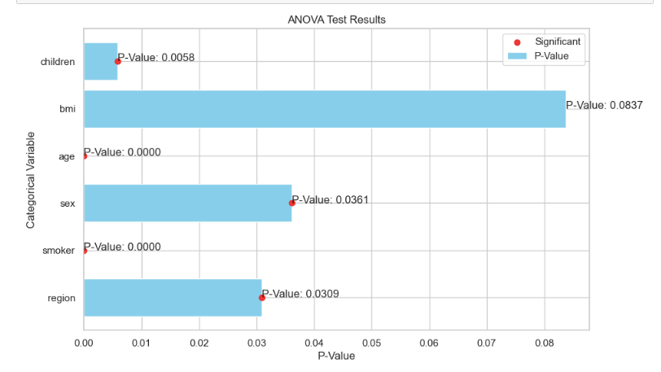
ANOVA
Statistical Analysis
We conducted ANOVA (Analysis of Variance), which is a statistical test used to compare the means of three or more groups to determine if there are significant differences among them. It's an extension of the t-test, which is used for comparing two groups.
ANOVA helps too understand the sources of variability within data. It breaks down the total variance into two components: variance between groups and variance within groups. By comparing these variances, we can determine if group differences are statistically significant.
NULL HYPOTESIS - Null Hypothesis – There is no significant difference among the categorical variables against the “charges”

Slide 7
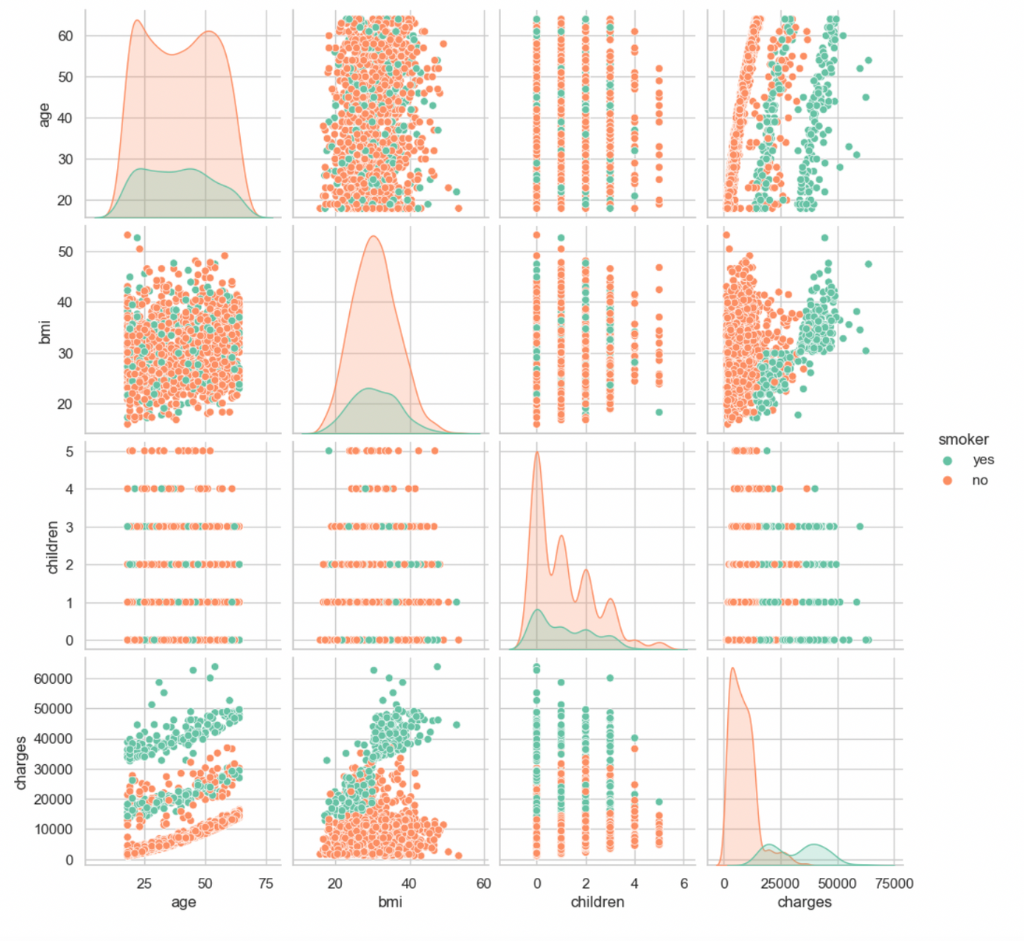
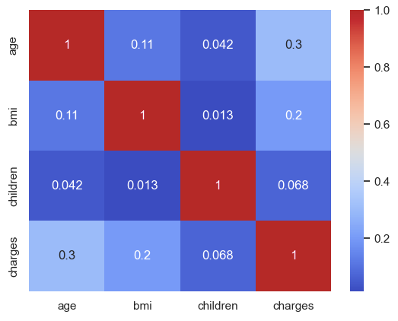
Correlation Analysis
From scatterplots its noticeable that smokers are usually have higher charges. Among those who do not smoke there are more parents

Slide 8
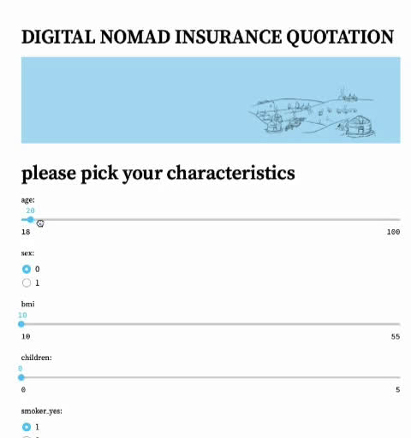

Slide 9
Modelling Results
50,000
Model | MAE | RMSE | R2
Linear Regression | 4184.857 | 6289.889 | 0.7113982
Decision Tree | 3407.539 | 5316.753 | 0.7937918
Random Forest | 3024.404 | 4991.066 | 0.8182813
Support Vector Machine | 2739.455 | 5062.639 | 0.8130322
40,000
30,000
Predicted Values
20,000
10,000
0
0
10,000
20,000
30,000
40,000
50,000
Actual Values

Slide 10
Further goals
Use the tool created by our team to calculate precise premium predictions for potential clients
Increase the amount of collected personal data to improve suggested machine learning algorithm
Develop a user-friendly interface or dashboard on company’s website for clients to input their personal data and receive instant premium quotes
Offer educational resources to help clients understand the factors that influence insurance premiums, empowering them to make informed decisions.
Implement robust security measures to protect the personal data of clients, as it is sensitive information.

